Slide 1
Tutorial 4 Formatting Text and Links

Slide 2
Objectives 4.1
Specify the vertical alignment of an element
Define list styles
Implement grouped selectors
Incorporate descendant selectors
Style a list as a navigation bar

Slide 3
Objectives 4.2
Work with dependent and independent classes
Set an image as a list marker
Create dynamic pseudo-classes

Slide 4
Using the vertical-align Property
Use the vertical-align property to position images and other elements vertically with text.
The property has several possible values:
top – The top of the image is aligned with the text.
middle – The image is aligned vertically centered with the text.
bottom – The bottom of the image is aligned with the text.

Slide 5
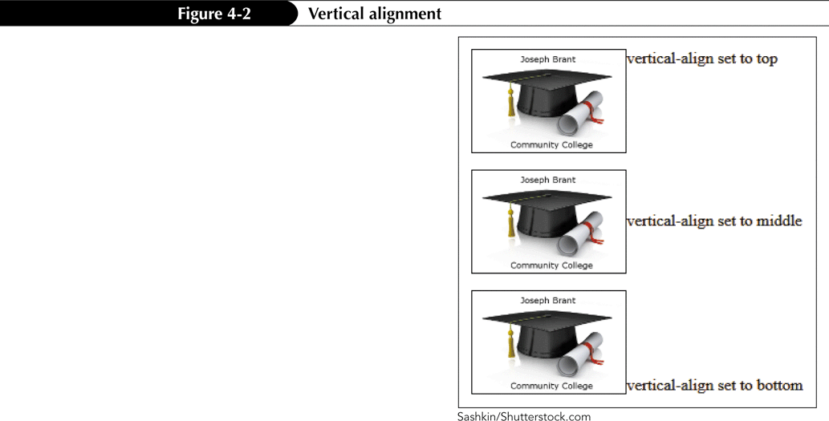

Using the vertical-align Property

Slide 6
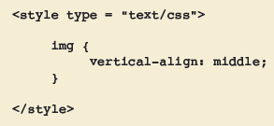
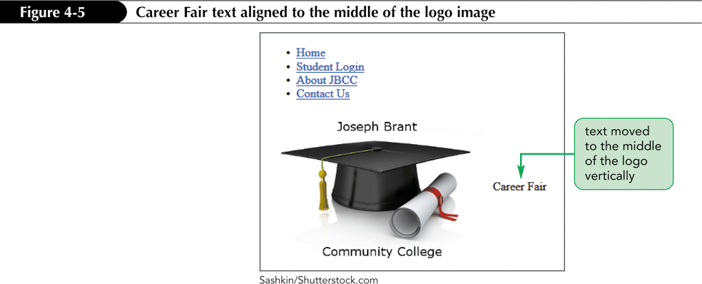
Using the vertical-align Property

Slide 7
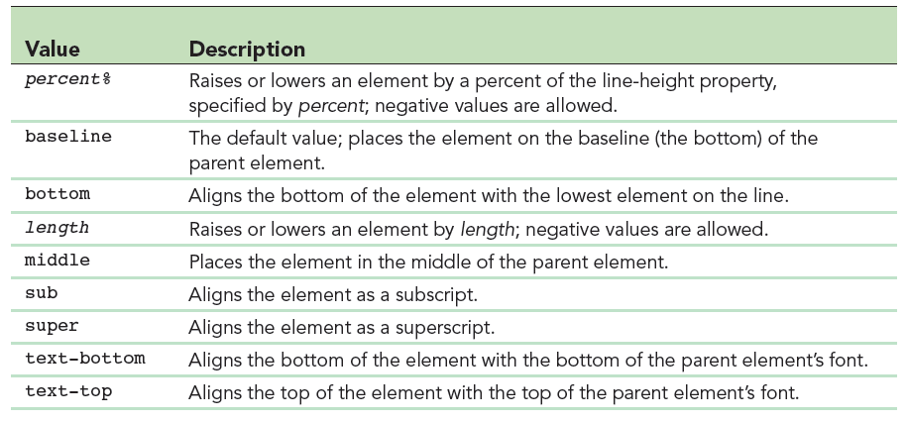
The vertical-align Property Values

Slide 8
Changing the Appearance of Lists
Lists can be enhanced by graphics and images.
The following properties can be used:
list-style-type: stylevalue;
list-style-position: positionvalue;
list-style-image: url(imagename);
Shorthand property: list-style: stylevalue url(imagename) positionvalue;

Slide 9
Using the list-style-type Property
Use the list-style-type property to change the appearance of the default solid bullet for unordered lists.
There are four list-style-type values for unordered lists:
disc – a filled circle (the default)
circle – a hollow circle
square – a filled square
none – no bullet is shown
ul { list-style-type: value; }

Slide 10
Using the list-style-type Property
There are the following list-style-type values for ordered lists:
decimal
decimal-leading-zero
lower-roman
upper-roman
lower-alpha
upper-alpha
none
ol { list-style-type: value; }

Slide 11
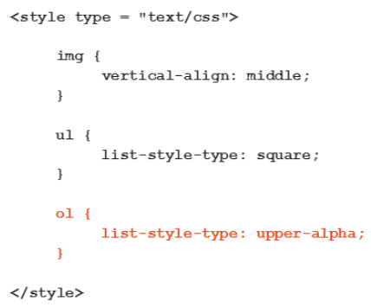
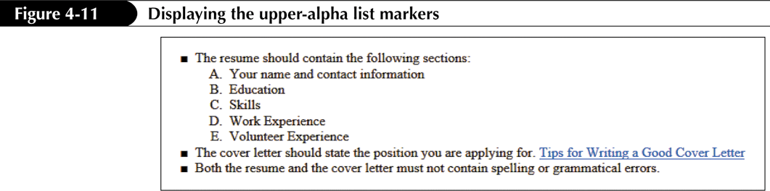
Using the list-style-type Property

Slide 12
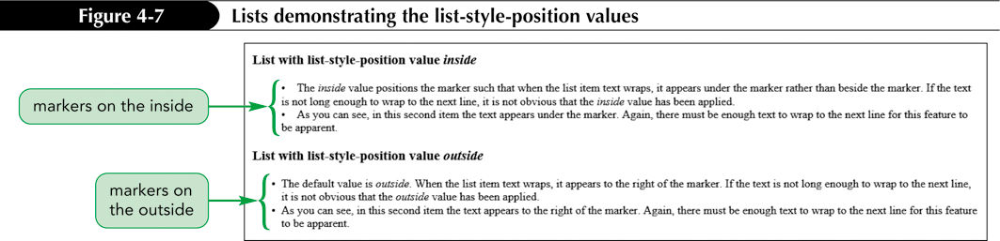
Using the list-style-position Property
Use the list-style-position property to change the position of the marker or bullet included with a list.
There are two list-style-position values:
inside
outside

Slide 13
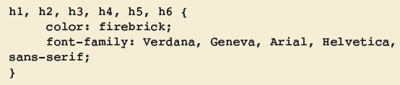
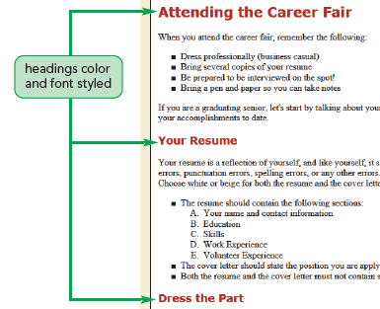
Using Groups of Selectors
Grouped selectors are selectors that share a common set of declarations and that are grouped into a comma-separated list.

Slide 14
Using Descendant Selectors
A descendant selector is a selector nested within another selector.
A space is used, without a comma, to indicate descendant selectors.
A comma is used between selectors when the style applies to all selectors in the group.
strong em {
color: maroon;
}

Slide 15
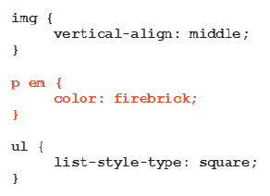
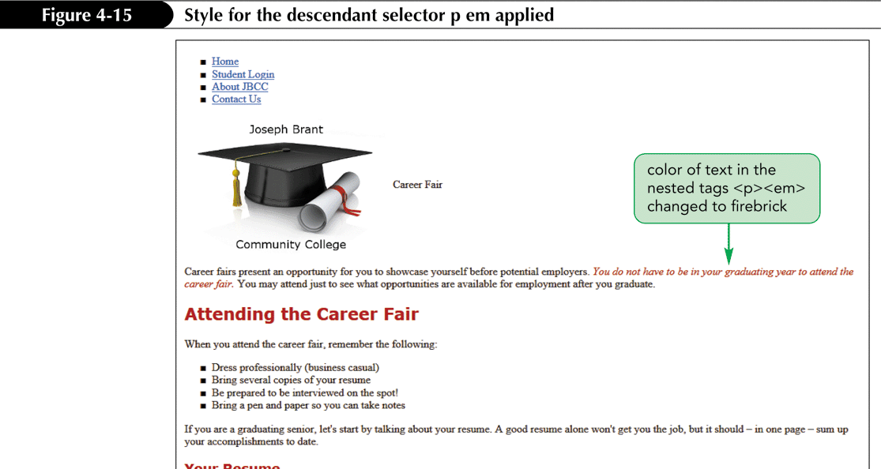
Using Descendant Selectors

Slide 16
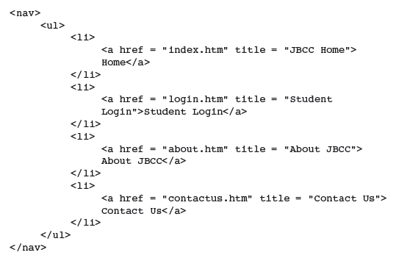
Styling a List of Hyperlinks
The nav element identifies a block of navigation links.

Slide 17
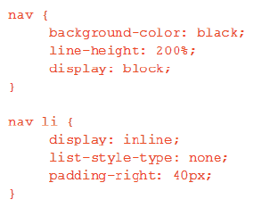
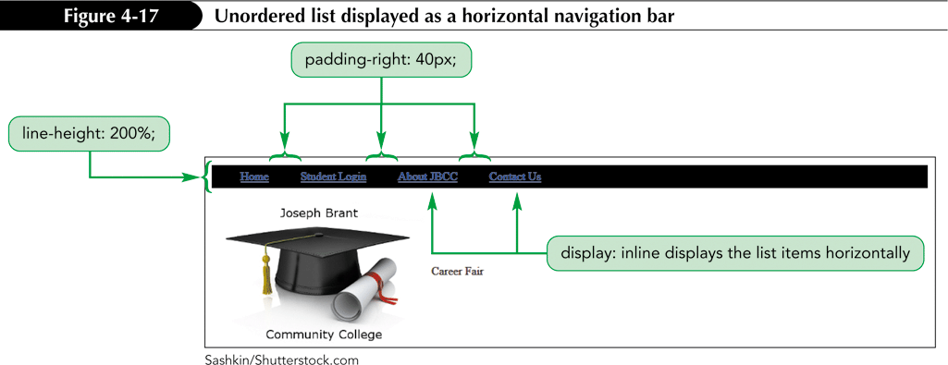
Styling a List of Hyperlinks

Slide 18
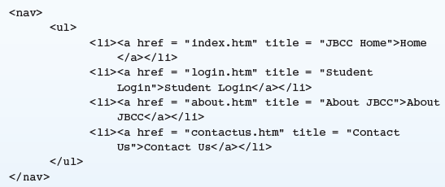
CSS Inheritance
CSS inheritance is a method whereby a child element inherits characteristics from its parent element.
The nav element is a parent of the ul element, and the ul element is a parent of the li element.

Slide 19
CSS Class Selector
A class selector is a name preceded by a period.
This name can then be applied to any HTML element.
Class selectors can format one or more instances of an element.
A class must be applied to the start tag of one or more elements on a Web page.
Classes can be dependent or independent.

Slide 20
Dependent Class
A dependent class styles a particular element.
Code syntax: selector.dependentclass { property1: value; property2: value; } selector – the name of the element dependentclass – the name of the dependent class
To apply the dependent class to an element: <element class = "dependentclass">

Slide 21
Rules for Class Names
A class name can contain only alphabetic or numeric characters.
A class name must be one word (no spaces).
A class name should describe the purpose of the class.
A class name should not begin with a number because not all browsers will recognize it.

Slide 22

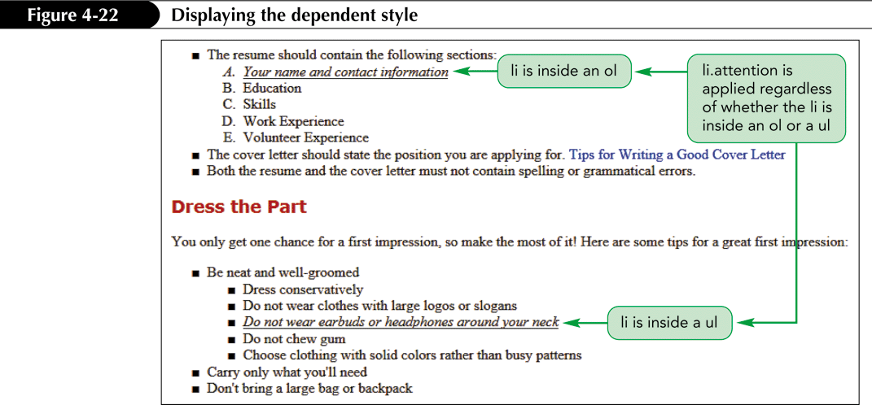
Dependent Selector Code
Code to apply the attention class: <li class = "attention">Your name and contact information</li>

Slide 23
Independent Class
An independent class styles any element.
Code syntax: selector.independentclass { property1: value; property2: value; } selector – the name of the element independentclass – the name of the dependent class
To apply an independent class to any element: <element class = "independentclass">

Slide 24


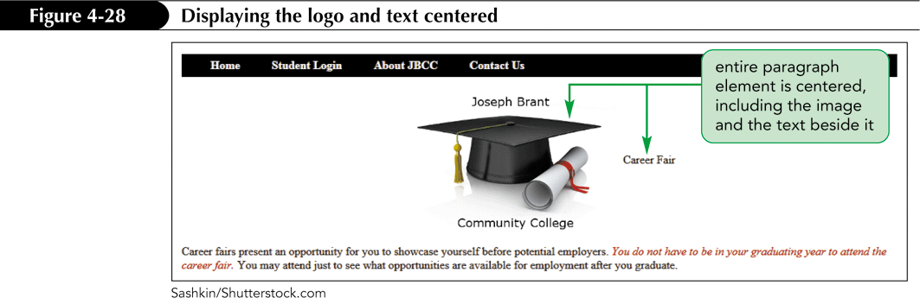
Independent Selector Code
Code to apply the center class:

Slide 25
Using the list-style-image Property
Use the list-style-image property to specify a graphic image instead of a bullet marker for a list.
Use a very small image for a bullet marker.
Code example: ul {
list-style-image: url(star.gif); }
url points to the image used as a bullet marker.

Slide 26
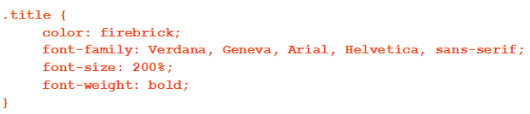
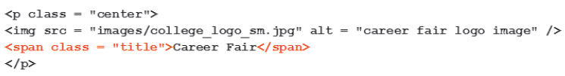

Using the span Element
The span element is a generic element that does not have any specific meaning, but it allows you to mark inline content.
span element syntax: <span>content</span>

Slide 27
Pseudo-Class Selectors
A pseudo-class is a class that exists in CSS but is not directly defined in HTML.
Pseudo-classes associated with the anchor element are used to achieve the mouse-over effect.
Link color defines the link state, which is whether a hyperlink has been clicked or not.

Slide 28
The Anchor Pseudo-Class Selectors
Using the anchor pseudo-class selectors, hyperlinks can be styled, based on the following four states:
a:link is the selector for normal links.
a:visited is the selector for visited links.
a:hover is the selector for the hover state (when the mouse pointer passes over the link).
a:active is the selector for active links (when a user holds down the mouse button to click a link).
Note that the colon does not have spaces before and after it.

Slide 29



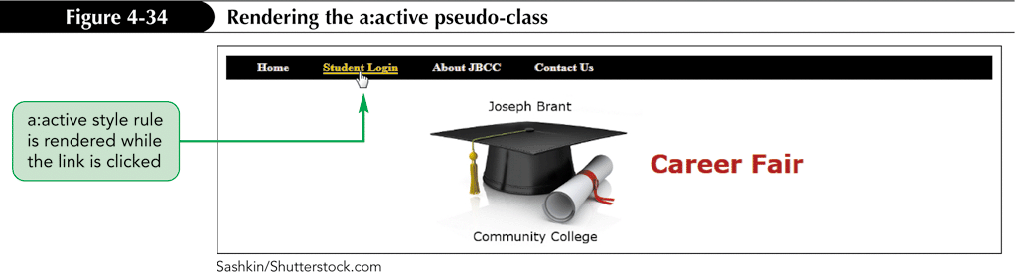

The Anchor Pseudo-Class Selectors
+

Slide 30
Setting Margins
The following properties are used to set margins:
margin-top
margin-right
margin-bottom
margin-left
Order is irrelevant.

Slide 31
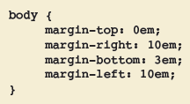
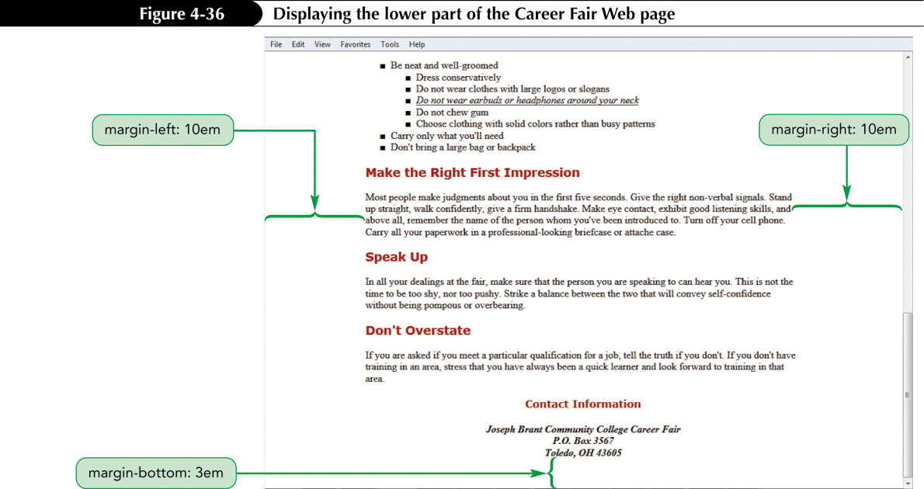
Setting Margins

